Slide 1
Terms implied by SGA 1979, s.13 & CRA 2015
Commercial Law
Lecture 15
Rachel Avery

Slide 2
SGA 1973, s.13(1)
‘Where there is a contract for the sale of goods by description…
…. there is an implied term that the goods will correspond with the description’
SGA s.13(1) is a condition (SGA s.13(1A)), but see
  SGA s.11(2)
  SGA s.11(4)
  SGA s.15A: in relation to non-consumer sales, breach of s. 13 to be treated as breach of warranty, IF ‘breach is so slight that it would be unreasonable for [B] to reject them’

Slide 3
Example
Advertisement (terms incorporated fully into resulting contract):
“For sale. 2007 Honda Civic automatic, only one owner, 10,000 miles, headrests, radio, excellent condition”
(Goode, Commercial Law)

Slide 4
Sale by description - meaning
Meaning of ‘sale by description’
  Sale of future or unascertained goods
    Are sold by description, as B will need to rely on description
  What about specific goods?
    Grant v Australian Knitting Mills
    ‘It may also be pointed out that there is a sale by description even though the buyer is buying something displayed before him on the counter: a thing is sold by description, though it is specific, so long as it is sold not merely as the specific thing but as a thing corresponding to a description, e.g., woolen under-garments, a hot-water bottle…’

Slide 5
Sale by description – meaning (II)
SGA 1979 s.13(3):
  “A sale of goods is not prevented from being a sale by description by reason only that, being exposed for sale or hire, they are selected by the buyer”
    Goods exposed and sold in self-service stores may be goods sold by description
    Scancom International A/S v RWH Enterprises Ltd (goods selected by reference to examples shown at an exhibition; not a sale by sample: sale by description)

Slide 6
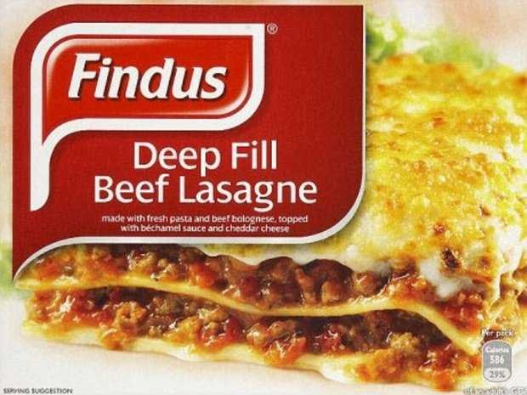
Sale by Description

Slide 7
Intention of the parties that description be a term of the contract
Sale not ‘by description’ unless parties intended the descriptive words to be a term of the contract
  Drake v Agnew: art dealer buying painting for art collector from specialist seller; painting referred to as a painting by ‘Van Dyck; specialist seller’s refs. to ‘Van Dyck’ clearly stated to be only expressions of opinion.
  Held: refs are mere expressions of opinion; sale cannot be one by description unless parties intended description to be a term of the contract

Slide 8
Descriptive words
Differentiate words that relate to the goods’ identity and descriptive words that relate to the goods’ attributes (e.g. quality, fitness for purpose)
  See: Ashington Piggeries v Hill
    Sale of ‘Norwegian herring meal fair average quality of the season’, herring contaminated, fatal to mink
    No breach of s.13 (but s.14)
    ‘Fair average quality of the season’ = attribute (quality)

Slide 9
Descriptive words (II)
Courts in past were too willing to recognise words of description as falling within s. 13
  Re Moore and Co Ltd and Landauer (sale of tinned fruit; delivered in packs of 24; supposed to be packed in packs of 30 according to statement in contract. Held: sale is by description; B entitled to reject the full consignment)
BUT see Reardon Smith Line v Yngvr Hansen-Tangen (ship built in different yard and given different hull number as originally stated)
  Re Moore is ‘excessively technical’
  Particular item in description must be a ‘substantial ingredient of the identity of the thing sold’
  Hull and yard number no special significance; merely meant to identify the vessel : are not words of description for purpose of s. 13

Slide 10
Description must be relied upon by B
B’s reliance on the description must be within reasonable contemplation of the parties
  Harlingdon & Leinster Enterprises Ltd v Christopher Hull Fine Art Ltd (sale of oil paintings; paintings described in the past as ‘by Munter’; S makes it clear that he is not an expert; B, art dealers specialising in German expressionists, buys; painting forgery)
  Held: B has not relied on S’s description of painting as being ‘by Munter’ => no sale by description

Slide 11
CRA 2015
Separate provision on goods ‘to be as described’ (CRA 2015, s.11)
  Substantially the same, with some additions
New provisions on digital content ‘to be as described’
  Digital content: data produced and supplied in digital form (s. 2(9))
  Contract to supply digital content to be treated as including a term that digital content will match description (s.36)
    If trial version before contract is made, digital content must match any description of it given, even if digital content is better than trial version
    Some terms treated as included (see Consumer Contracts Regulations 2013 (Statutory Instrument 2013 No. 3134).

Slide 12
CRA2015 (II)
s.39 covers case where digital content is supplied by transmission:
  e.g. downloading
  Digital content treated as ‘supplied’ when:
    content reaches consumer’s device; or
    If earlier, when content reaches another trader chosen by consumer to supply a service by which digital content reaches device
    CRA s.36 applies in such a case
  s.39 also covers digital content transmitted to consumer under ‘processing facility’ (e.g. cloud music streaming facility): => s. 36 applies
s.40 covers cases where digital content is modified/updated after initial provision
  s.36 applies to modified digital content as it applies in relation to digital content supplied under contract
  Adding/improving features is permissible if digital content continues to match description

Slide 13
Cf. sale by description and sale by model
CRA 2015 s. 14 applies to contracts to supply goods by reference to a model.
Contract to be treated as including a term that goods will match model ‘except to the extent that any differences between the model and the goods are brought to the consumer’s attention before the consumer enters into the contract.’

